Slide 1


NOSQL
Jay Kakadiya(160410116046)
Kaushiki Kansara(160410116048)
Devangini Kathad(160410116049)
Kaustubh Wade(160410116050)

Slide 2
INDEX
What is NoSQL?
Need of NoSQL.
NoSQL Types
Key Value Paired Based
Column Based
Document Based
Graph Based
CAP Theorem
Advantages Of NoSQL
What is not provide by NoSQL
Where to use NoSQL
Conclusion

Slide 3
What is NoSQL?
Stands for Not Only SQL. Term was redefined by Eric Evans after Carlo Strozzi.
Class of non-relational data storage systems.
Do not require a fixed table schema nor do they use the concept of joins.
Relaxation for one or more of the ACID properties (Atomicity, Consistency, Isolation, Durability) using CAP theorem.

Slide 4
Need of NoSQL
Explosion of social media sites (Facebook, Twitter, Google etc.) with large data needs. (Sharding is a problem)
Rise of cloud-based solutions such as Amazon S3 (simple storage solution).
Just as moving to dynamically-typed languages (Ruby/Groovy), a shift to dynamically-typed data with frequent schema changes.
Expansion of Open-source community.
NoSQL solution is more acceptable to a client now than a year ago.

Slide 5
NoSQL Types
NoSQL database are classified into four types:
-Key Value pair based
-Column based
-Document based
-Graph based

Slide 6
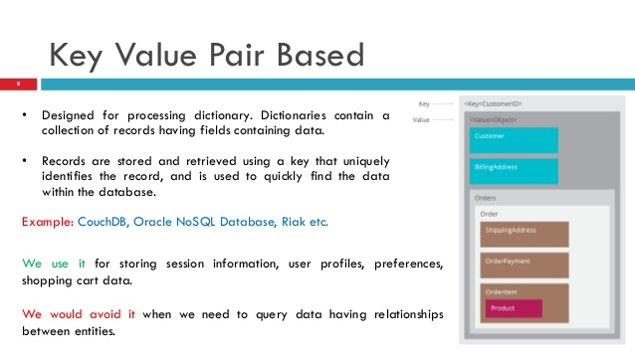
Key Value Pair Based
Designed for processing dictionary.
Dictionaries contain a collection of records
having fields containing data.
Records are stored and retrieved using a key
that uniquely identifies the record, and is used
to quickly find the data within the database.
Example: CouchDB, Oracle NoSQL Database, Riak etc.
We use it for storing session information, user profiles,
preferences, shopping cart data.
We would avoid it when we need to query data having
relationships between entities.

Slide 7
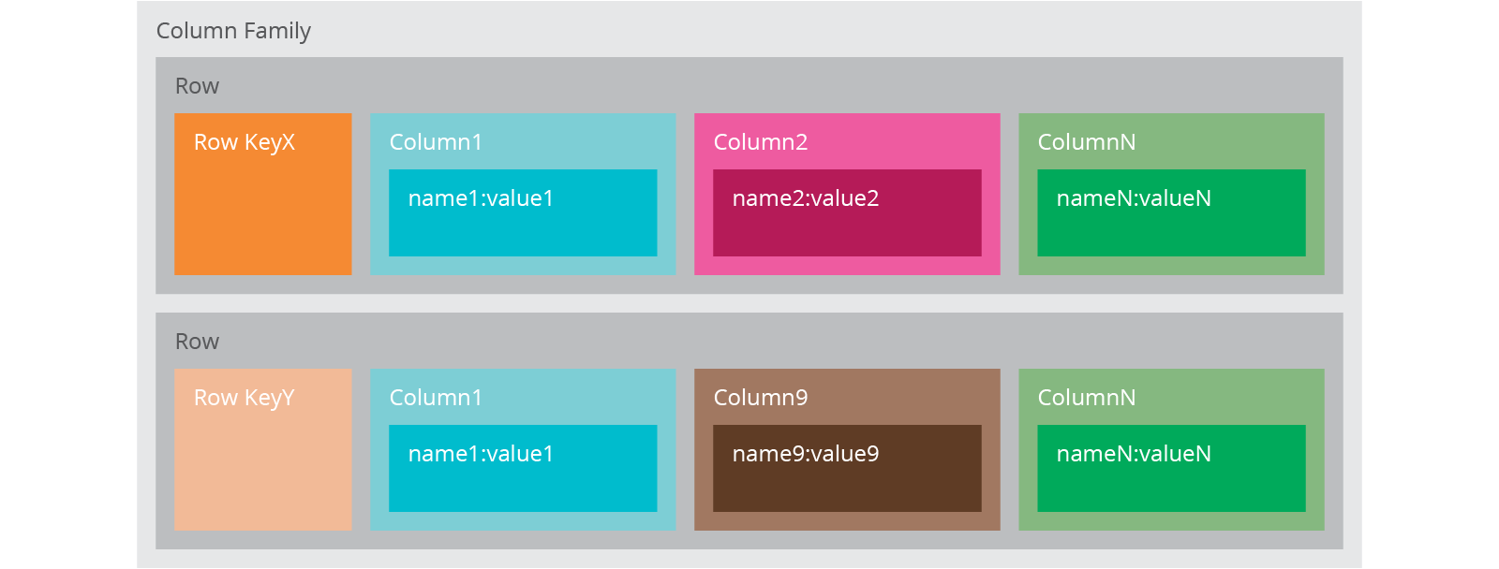
Column based
It store data as Column families containing
rows that have many columns associated
with a row key.
Each row can have different columns.
Column families are groups of related data
that is accessed together.
Example: Cassandra, HBase, Hypertable, and Amazon DynamoDB.
We use it for content management systems, blogging platforms, log aggregation.
We would avoid it for systems that are in early development, changing query patterns.

Slide 8
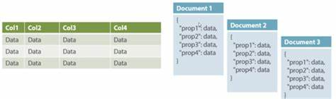
Document Based
The database stores and retrieves documents.
It stores documents in the value part of the
key-value store.
Self- describing, hierarchical tree data structures
consisting of maps, collections, and scalar values.
Example: Lotus Notes, MongoDB, Couch DB, Orient DB, Raven DB.
We use it for content management systems, blogging platforms, web analytics, real-time analytics, e- commerce applications.
We would avoid it for systems that need complex transactions spanning multiple operations or queries against varying aggregate structures.

Slide 9
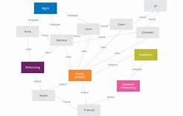
Graph Based
Store entities and relationships between
these entities as nodes and edges of a
graph respectively.
Entities have properties. Traversing the
relationships is very fast as relationship
between nodes is not calculated at query
time but is actually persisted as a relationship.
Example: Neo4J, Infinite Graph, OrientDB, FlockDB.
It is well suited for connected data, such as social
networks, spatial data, routing information for
goods and supply.

Slide 10
CAP Theorem
According to Eric Brewer a distributed system has 3 properties :
Consistency
Availability
Partitions
We can have at most two of these three properties for any shared-data system.
To scale out, we have to partition. It leaves a choice between consistency and availability. ( In almost all cases, we would choose availability over consistency)
Everyone who builds big applications builds them on CAP : Google, Yahoo, Facebook, Amazon, eBay, etc.

Slide 11
Advantages of NoSQL
Cheap and easy to implement (open source)
Data are replicated to multiple nodes (therefore identical and fault- tolerant) and can be partitioned
-When data is written, the latest version is on at least one node and then replicated to other nodes
-No single point of failure
Easy to distribute
Don't require a schema

Slide 12
What is not provided by NoSQL
Joins
Group by
ACID transactions
SQL
Integration with applications that are based on SQL

Slide 13
Where to use NoSQL
NoSQL Data storage systems makes sense for applications that process very large semi-structured data –like Log Analysis, Social Networking Feeds, Time-based data.
To improve programmer productivity by using a database that better matches an application's needs.
To improve data access performance via some combination of handling larger data volumes, reducing latency, and improving throughput.

Slide 14
Conclusion
All the choices provided by the rise of NoSQL databases does not mean the demise of RDBMS databases as Relational databases are a powerful tool. We are entering an era of Polyglot persistence, a technique that uses different data storage technologies to handle varying data storage needs. It can apply across an enterprise or within an individual application.

Slide 15
THANK
YOU

